Slide 1
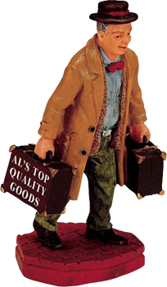
Travelling Salesman problem

Slide 2

Presented By:
Sharif Ahmed
Shovon Paul
Mahfuzur Rahman Rafi
Imtiaz Ahamed

Slide 3

Presentation to:
Md. Shamsujjoha Senior Lecturer of CSE Department , East West University

Slide 4
OVERVIEW
Introduction
What is TSP ?
Application
Where we use TSP ?
Functions
How to solved TSP ?
Conclusion

Slide 5
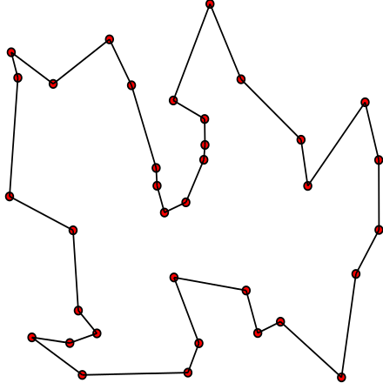
Introduction
The goal of the Traveling Salesman Problem (TSP) is to find the “cheapest” tour of a select number of “cities” with the following restrictions:
You must visit each city once and only once
You must return to the original starting point

Slide 6
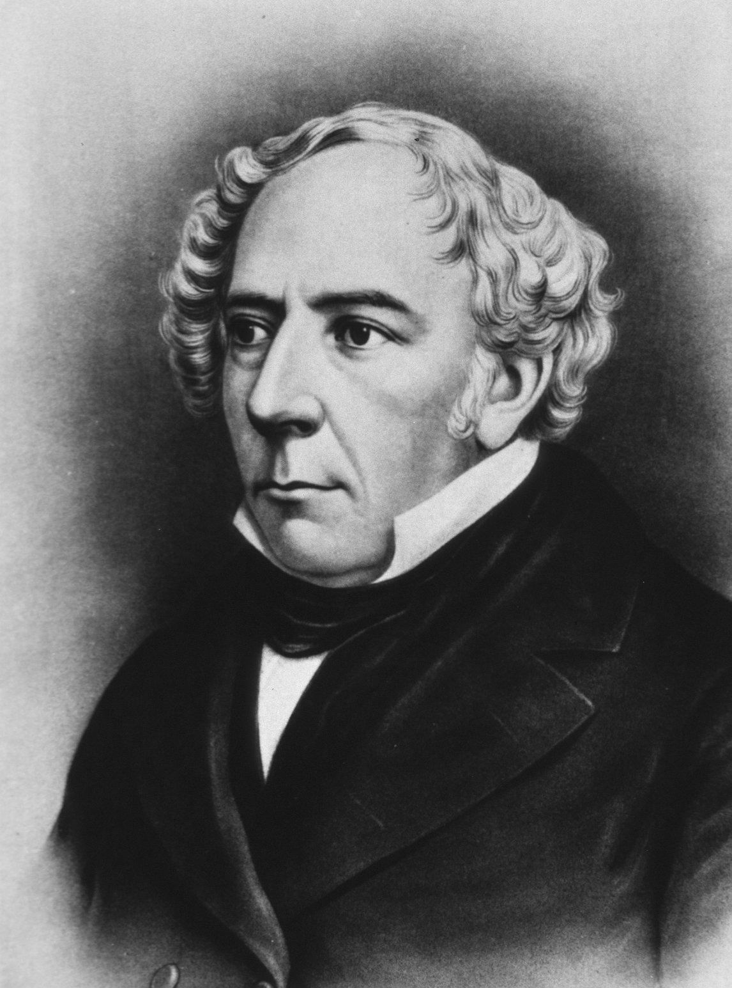
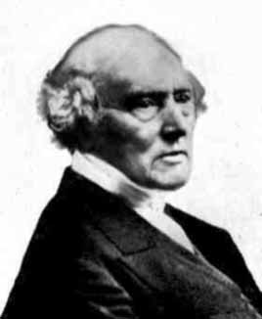
History
Sir William Hamilton
1805 - 1865
Discovered quaternions in 1843
Invented Icosian Game in 1857
Hamiltonian Circuits
T. P. Kirkman
1806-1895
In 1856, he published sufficient
conditions for a polyhedral
graph to have a Hamiltonian
circuit.

Slide 7

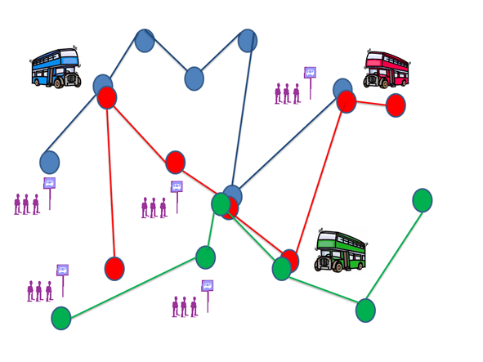
Application
Computer wiring: Reported a special case of connecting components on a computer board. Modules are located on a computer board and a given subset of pins has to be connected. In contrast to the usual case where a Steiner tree connection is desired, here the requirement is that no more than two wires are attached to each pin. Hence we have the problem of finding a shortest Hamiltonian path with unspecified starting and terminatingpoints.
School bus routing:
In the problem of scheduling buses as a variation of the TSP with some side constraints. The objective of the scheduling is to obtain a bus loading pattern such that the number of routes is minimized, the total distance travelled by all buses is kept at minimum, no bus is overloaded and the time required to traverse any route does not exceed a maximum allowed policy.

Slide 8
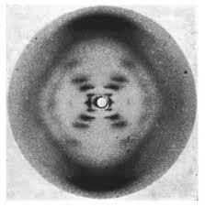
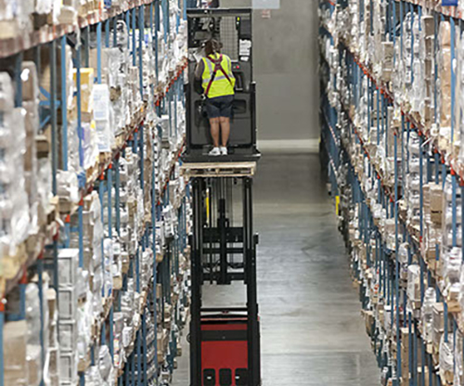
Application
X-Ray crystallography: X-Ray is an important application of the TSP. X-ray diffractometer is used to obtain information about the structure of crystalline material. To this end a detector measures the intensity of X- ray reflections of the crystal from various positions.
The order-picking problem in warehouses:This problem is associated with material handling in a warehouse . Assume that at a warehouse an order arrives for a certain subset of the items stored in the warehouse. Some vehicle has to collect all items of this order to ship them to thecustomer. The relation to the TSP is immediately seen. The storage locations of the itemscorrespond to the nodes of the graph.

Slide 9
TSP Algorithm
Find max vertex from input
A[V][V];
Don’t[V];
For each V find
{
Minimum cycle path(v,0);
}
Mi=Find minimum path starting point from cost function;
Do minimum cycle path(mi,1)
Print the TSP cycle

Slide 10
TSP Algorithm
Minimum cycle path (t,flag)
It=vertex; Sum=0; Source=t;
If(flag!=0) Then do push(source);
vertex from each vertex
While(1)
{
For each v ∈ adj [u]
{
If (dont[u]!=0 && v!=u)
Find minimum
}
It--;
If(it==1)
{
if (flag!=0) then push ource to get path track;
Or do
sum++ and push sum to cost function And break;
}
Worst case complexity big O(n³)

Slide 11
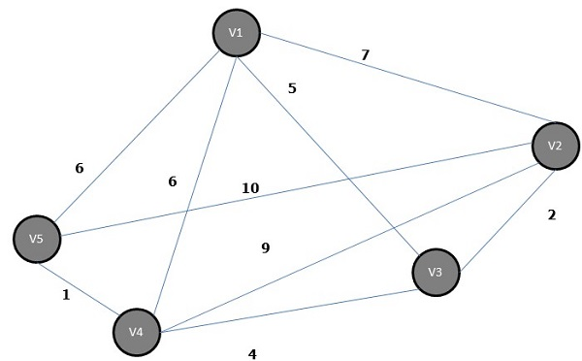
Undirected Complete Graph
Distance | v1 | v2 | v3 | v4 | v5
v1 | 0 | 7 | 5 | 6 | 6
v2 | 7 | 0 | 2 | 9 | 10
v3 | 5 | 2 | 0 | 4 | 9
v4 | 6 | 9 | 4 | 0 | 1
v5 | 6 | 10 | 9 | 1 | 0

Slide 12
Result of TSP Path
Minimum cost :20
Maximum cost:25
TSP Path :
2->3->4->5->1->2

Slide 13
Any Questions?

Slide 14
THANK YOU

